Slide 1


CARLTON CORPORATION CONSTRUCTION | DECEMBER 2020
CCC
01.

Slide 2





Our Board
Engr. M.O. Ayeola
Dr. Emehi C.
Executive Director
Director
Engr.Agwupuye L.
President/C.EO.
Prof. N.I Okorie
Mr. Ajani A.A.
Director
Director

Slide 3
Our Vision
Our Mission
To be a world-class infrastructure construction and Real Estate Development company committed to total customer satisfaction and enhancing shareholder's value, by building on our strengths - innovative designs, superlative quality of material, cutting-edge technology, timely completion and demonstrating the highest standards of workmanship.
To work towards being in the position of a market leader in Infrastructure Construction & Real Estate Development Projects.
03.
CARLTON CORPORATION CONSTRUCTION | DECEMBER 2020

Slide 4
Key Talking Points
What's on the agenda?
— Site Investigation Summary
— Objectives of Site Investigation
— Methods of Site Investigation
— Techniques in Site Investigation
— Things to keep in mind
04.
CARLTON CORPORATION CONSTRUCTION | DECEMBER 2020

Slide 5
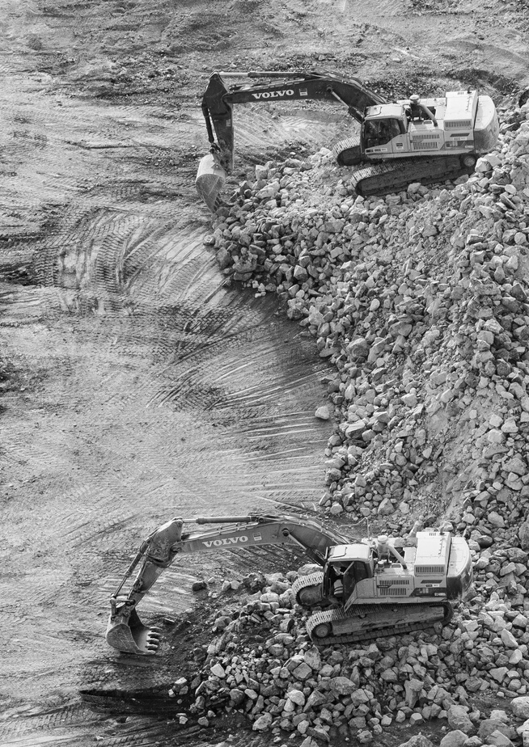
Site Investigation
Statistics show that 80% of problems encountered on construction projects are due to unforeseen ground conditions that could have been avoided if a suitable site investigation was carried out.
Before the engineer can design a foundation intelligently, he must have a reasonably accurate conception of the physical properties and arrangement of the underlying materials. The field and laboratory investigations required to obtain this essential information are called soil exploration or site investigation.
05.
CARLTON CORPORATION CONSTRUCTION | DECEMBER 2020

Slide 6
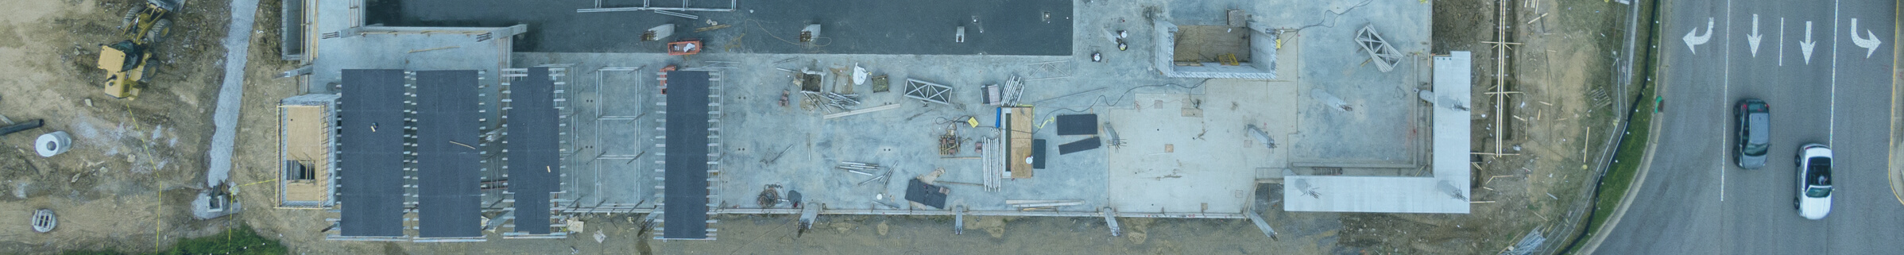
SITE INVESTIGATION
A site investigation simply is the process of the collection of information, the appraisal of data, assessment, and reporting without which the hazards in the ground beneath the site cannot be known.
Site investigation is carried out in order to enable a geotechnical and geoenvironmental assessment of the ground conditions and analysis of the engineering and environmental considerations related to the proposed development.
THE BEGINNING
06.
CARLTON CORPORATION CONSTRUCTION | DECEMBER 2020

Slide 7
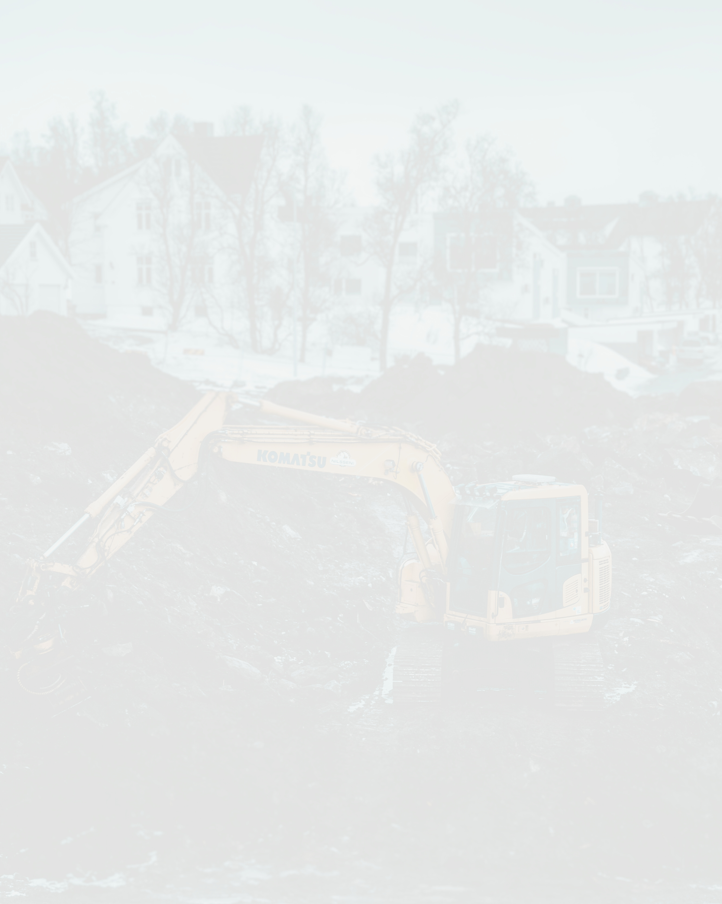
SITE INVESTIGATION
Site Investigation is the process of collecting information, assessment of the data and reporting potential hazards beneath a site which are unknown.
Site Investigation is grouped into the following stages:
1. Soil Investigation
2. Geologic survey maps
3. Preliminary investigation
4. Detailed Site Investigation
5. Supplementary investigation and construction control.
A SUMMARY
07.
CARLTON CORPORATION CONSTRUCTION | DECEMBER 2020

Slide 8
Site Investigation Purpose and Objectives
The objective of a site investigation is to gather the information needed to carry out the risk assessment, in order to be in a position to assess the presence and significance of contamination of land.The optimum objective of a site investigation is to determine as accurately as may be required:
1
2
3
The nature and sequence of strata
The groundwater conditions at the site
The physical properties of soil and rock underlying the site
08.
CARLTON CORPORATION CONSTRUCTION | DECEMBER 2020

Slide 9
Site Investigation Purpose and Objectives
4
5
6
The mechanical properties such as the strength of different soil or rock strata
To access the general suitability of the site
To achieve the safe and economical design of foundations and temporary works
09.
CARLTON CORPORATION CONSTRUCTION | DECEMBER 2020

Slide 10
Site Investigation Purpose and Objectives
7
8
9
To know the nature of each stratum and engineering properties of the soil and rock, which may affect the design and mode of construction of the proposed structure and foundation
To foresee and provide against difficulties that may arise during construction due to ground and other local conditions
To find out the sources of construction material and selection of sites for disposal of water or surplus material
10.
CARLTON CORPORATION CONSTRUCTION | DECEMBER 2020

Slide 11
Site Investigation Purpose and Objectives
10
11
12
To investigate the occurrence or causes of all-natural and man-made changes in conditions and the results arising from such changes
To ensure the safety of surrounding existing structures
To design for the failed structures or remedial measures for the structures deemed to be unsafe
11.
CARLTON CORPORATION CONSTRUCTION | DECEMBER 2020

Slide 12
Reconnaissance Survey
Desk Study Survey
Walk-Over Survey
ccc
Preliminary Survey
Methodology of Site Investigation
The preliminary survey is more than just survey, it is understanding the appropriate horizontal and vertical datum, the standard data libraries and building the foundation for future work on the project.
Final Survey
A survey showing the house upon completion show all the improvements in relation to the property lines, building lines and easements.
12.

Slide 13
Reconnaissance Survey
Desk Study Survey
Walk-Over Survey
The term ‘desk study’ or ‘desktop study’ refers to a study that is carried out purely through research, rather than physical investigations, that is, it can be done sitting at a desk. Desktop studies can provide an initial understanding of a subject or situation, identify potential risks and inform the detail, scope and methodology of subsequent investigations.
A walkover survey is a basic site survey which can form part of the early site investigation process at the beginning of a project. It involves walking over the site and the surrounding area and recording any observed information which may be relevant to the project. It may be part a wider desk-based study of the site.
13.
CARLTON CORPORATION CONSTRUCTION | DECEMBER 2020

Slide 14
ccc
Preliminary Survey
Preliminary survey includes gathering geospatial data about the proposed route and the project requirements for data outputs. This includes the establishment on the ground of the proposed route and location of terrain and physical features (both man made and environmental). The preliminary survey is more than just survey, it is understanding the appropriate horizontal and vertical datum, the standard data libraries and building the foundation for future work on the project.
15.
CARLTON CORPORATION CONSTRUCTION | DECEMBER 2020

Slide 15
ccc
Final Survey
A survey showing the house upon completion show all the improvements in relation to the property lines, building lines and easements.
The objective of this phase is to fill any gap in the previous program and to make sure that sub-surface condition of each structure is well defined.
15.
CARLTON CORPORATION CONSTRUCTION | DECEMBER 2020

Slide 16
Techniques in Site Investigation
What are the techniques in Site Investigation?
— Soil and Rock Sampling
— Soil Vapour Sampling
— Direct Measurement oF Vapour Flux
— Well Development
—Well Purging and Sampling
—Residual Saturation
16.
CARLTON CORPORATION CONSTRUCTION | DECEMBER 2020

Slide 17
1
Geologic Observations and Interpretations
ccc
Understanding the geology at a site is critical in designing and implementing site assessment and remediation programs. Observations of soil and rock types encountered during site investigations should be integrated with all site findings and correlated with the local geologic environment
Soil and Rock Sampling
2
Sample Collection
3
Sampling to Delineate Contamination
The goal of the site assessment is to determine the nature and extent of contamination. The quality and integrity of samples, sample locations, and other field observations will strongly influence interpretation of site conditions
Subsurface sample locations should be guided by the underlying geology, contaminant characteristics, and field conditions to determine the extent and magnitude of contamination
17.
CARLTON CORPORATION CONSTRUCTION | DECEMBER 2020

Slide 18
1
Soil Gas Surveys
ccc
Soil gas surveys are an effective means to locate potential release points of contaminant vapors and are a useful method to approximate the aerial extent of contamination
Soil Vapour Sampling
2
Laboratory Analysis of Soil Gas Samples
This guideline is intended for use whenever soil gas samples are collected for the purpose of conducting a health risk assessment for submission to Site Assessment and Mitigation (SAM).
18.
CARLTON CORPORATION CONSTRUCTION | DECEMBER 2020

Slide 19
ccc
Direct Measurement of Vapour Flux
Due to site conditions it is sometimes necessary to directly measure the vapor flux though the floor of a structure. A flux chamber is used for this type of measurement. A flux chamber consists of an enclosed chamber that is placed on the surface to directly measure emissions. Flux chambers can be used to take either active or passive samples. Passive flux chambers have not been adequately tested under field conditions, and are therefore not recommended at this time and will not be discussed further. Active flux chambers measure vapor concentrations through time.
19.
CARLTON CORPORATION CONSTRUCTION | DECEMBER 2020

Slide 20
ccc
Well Development
The goal of well development is to improve hydraulic communication between the geologic formation and the well. Hydraulic communication is degraded when clay and silt in the formation (or in fractures), and/or drilling muds, are smeared on the borehole wall during the drilling process. Well development improves hydraulic communication by eliminating or reducing this smear. Development also improves the filtering action of the filter pack that surrounds the well casing
20.
CARLTON CORPORATION CONSTRUCTION | DECEMBER 2020

Slide 21
ccc
Well Purging and Sampling
This guideline has been developed to provide for consistent and representative sampling of groundwater monitoring wells. The well or wells to be sampled are assumed to be properly constructed and developed. This section focuses on sampling of groundwater for dissolved organic chemicals but can also be applied to sampling of inorganic compounds.
21.
CARLTON CORPORATION CONSTRUCTION | DECEMBER 2020

Slide 22
ccc
Residual Saturation
Soil and groundwater impacts may include the presence of NAPL. Depending on the physical properties of the contaminant, the NAPL may be lighter or denser than water. In general, contaminants such as fuels (e.g., TPH) have densities that are lower than water and are commonly referred to as LNAPL. Chlorinated hydrocarbons (CHCs) have densities that are higher than water and are commonly referred to as DNAPL.
22.
CARLTON CORPORATION CONSTRUCTION | DECEMBER 2020

Slide 23


CARLTON CORPORATION CONSTRUCTION | DECEMBER 2020
ccc
Thanks for listening!
For questions or concerns,
email us at hello@carltoncorporation.com.
We're here to help!

